Slide 1
Software Engineering
Sobia Iftikhar
Sobia.Iftikhar@nu.edu.pk
Week 02

Slide 2
Content
software process,
Fundamental Software Engineering Activities
Linear and Parallel Software
Software Process Framework
Software process models,
Process Improvement
The waterfall model,
Waterfall model phases,
Waterfall model problems,

Slide 3
Class 04 15-feb-2021

Slide 4
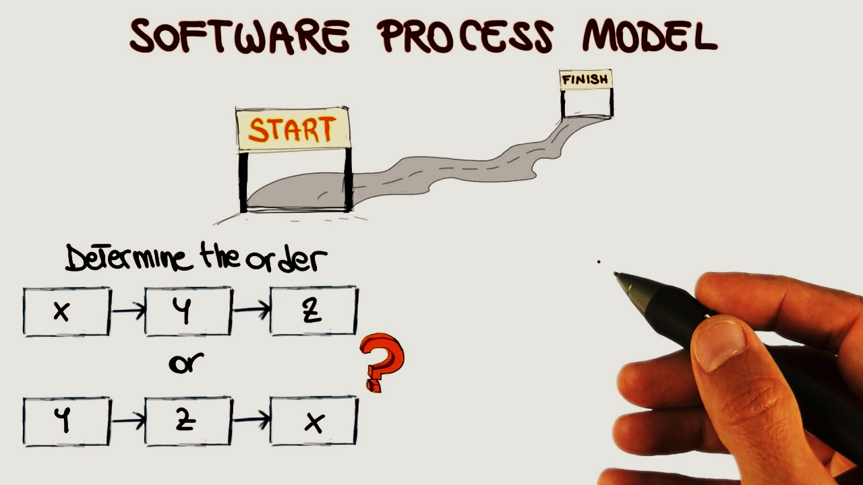
Software Process
A software process is a set of related activities that leads to the production of a software system.

Slide 5
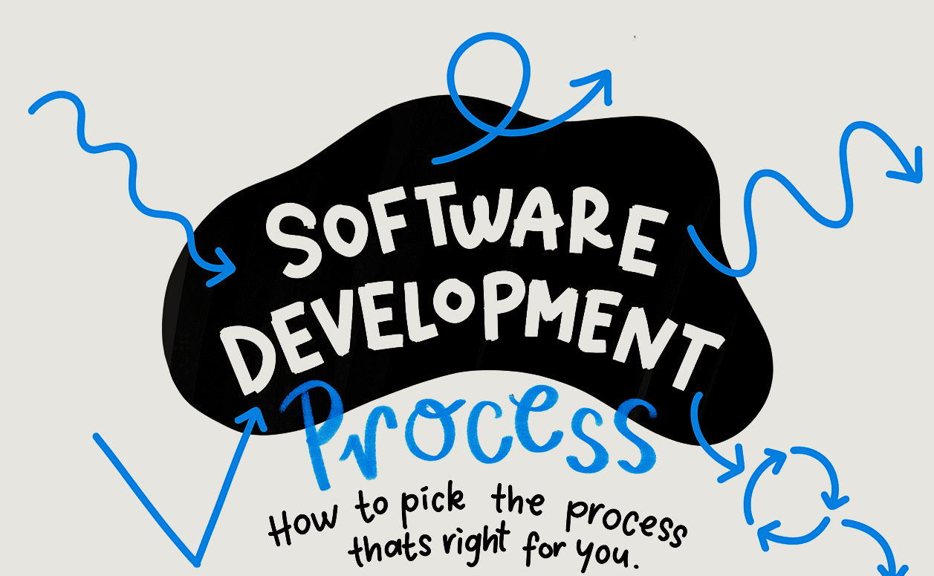
Software Process
There is no universal software engineering method that is applicable to all of them. Consequently, there is no universally applicable software process.
The process used in different companies depends on the type of software being developed, the requirements of the software customer, and the skills of the people.

Slide 6
Software Process Must Include The Following Four Activities:
Software specification (or requirements engineering):
Define the main functionalities of the software and the constrains around them.
Software design and implementation:
The software is to be designed and programmed.
Software verification and validation:
The software must conforms to it’s specification and meets the customer needs.
Software evolution (software maintenance):
The software is being modified to meet customer and market requirements changes.

Slide 7
Linear and Parallel Software
A linear process flow executes each of the five framework activities in sequence, beginning with communication and culminating with deployment.
Communication
Planning
Modeling
Construction
Deployment

Slide 8
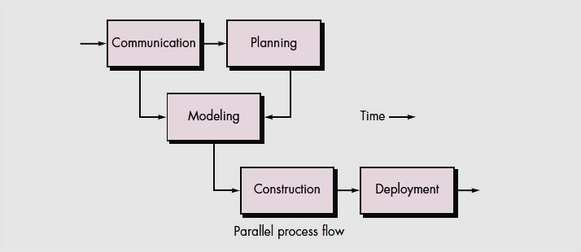
Parallel Process
Executes One Or More Activities In Parallel With Other Activities.

Slide 9
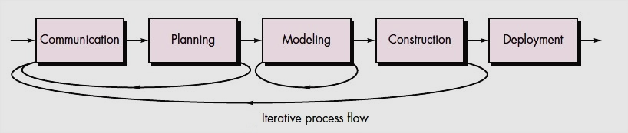
Iterative Process Flow
An iterative process flow repeats one or more of the activities before proceeding to the next.

Slide 10
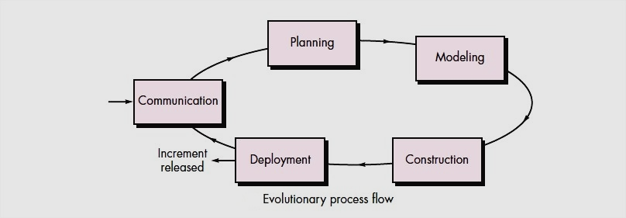
Evolutionary Process
An evolutionary process flow executes the activities in a “circular” manner.

Slide 11
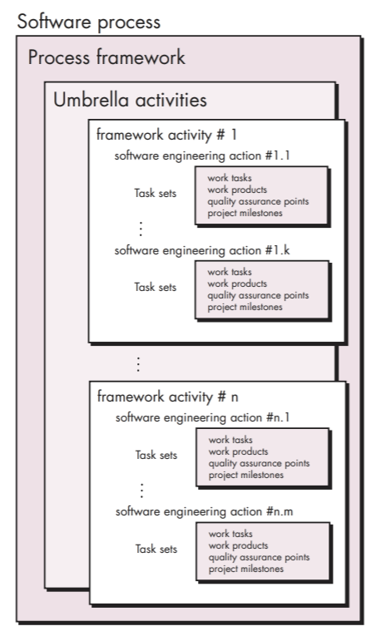
Software Process Framework
Each framework activity is populated by a set of software engineering actions.
Each software engineering action is defined by a task set that identifies the work tasks that are to be completed.
The work products that will be produced, the quality assurance points that will be required, and the milestones that will be used to indicate progress.

Slide 12
Process Improvement
there is a constant demand from industry for cheaper, better software, which has to be delivered to ever-tighter deadlines.
Consequently, many software companies have turned to software process improvement as a way of enhancing the quality of their software, reducing costs, or accelerating their development processes.
Process improvement means understanding existing processes and changing these processes to increase product quality and/or reduce costs and development time

Slide 13
Two quite different approaches to process improvement
The process maturity approach
which has focused on improving process and project management and introducing good software engineering practice into an organization.
The primary goals of this approach are improved product quality and process predictability.
The agile approach
Which has focused on iterative development and the reduction of overheads in the software process.
The primary characteristics of agile methods are rapid delivery of functionality and responsiveness to changing customer requirements.

Slide 14
Process Improvement
Measure
Change
Analyze
You measure one or more attributes of the software process or product.
The current process is assessed, and process weaknesses and bottlenecks are identified
Process changes are proposed to address
some of the identified process weaknesses

Slide 15
Software Process Model
A software process model is an abstraction of the actual process, which is being described.
It can also be defined as a simplified representation of a software process.
Each model represents a process from a specific perspective.
Basic software process models on which different type of software process models can be implemented

Slide 16
Waterfall Model
The waterfall model is a sequential approach, where each fundamental activity of a process represented as a separate phase, arranged in linear order.
In the waterfall model, you must plan and schedule all of the activities before starting working on them (plan-driven process).
The waterfall model, sometimes called the classic life cycle,

Slide 17
Waterfall Model
Communication: Requirement gathering
Planning: Estimation scheduling tracking
Modeling: Analysis Design
Construction: Code Test
Deployment: Delivery Support Feedback

Slide 18
Water Fall Model
Requirements analysis and definition
The system’s services, constraints, and goals are established by consultation with system users. They are then defined in detail and serve as a system specification.
System and Software Design
The systems design process allocates the requirements to either hardware or software systems. It establishes an overall system architecture.

Slide 19
Water Fall Model
Implementation and unit testing
The system’s services, constraints, and goals are established by consultation with system users. They are then defined in detail and serve as a system specification.
Integration and system testing
The systems design process allocates the requirements to either hardware or software systems. It establishes an overall system architecture.
Operation and maintenance
Maintenance involves correcting errors that were not discovered in earlier stages of the life cycle, improving the implementation of system units, and enhancing the system’s services as new requirements are discovered.

Slide 20
A variation in waterfall model
A variation in the representation of the waterfall model is called the V-model.
V Model is a highly disciplined SDLC model in which there is a testing phase parallel to each development phase.
The V model is an extension of the waterfall model in which testing is done on each stage parallel with development in a sequential way

Slide 21
V-Model
Requirement
Modeling
Acceptance
Testing
Architectural
Design
System Testing
Component
Design
Verification
Integration
Testing
Validation
Code
Generation
Unit
Testing
Executable Product

Slide 22
Issues With Waterfall Model
Real projects rarely follow the sequential flow that the model proposes. Although the linear model can accommodate iteration, it does so indirectly. As a result, changes can cause confusion as the project team proceeds.
It is often difficult for the customer to state all requirements explicitly. The waterfall model requires this and has difficulty accommodating the natural uncertainty that exists at the beginning of many projects.
The customer must have patience. A working version of the program(s) will not be available until late in the project time span. A major blunder, if undetected until the working program is reviewed, can be disastrous.

Slide 23
Class 05 16-feb-2021

Slide 24
Content
Incremental development
Incremental development benefits,
Incremental development problems,
Integration and configuration,
Types of reusable software

Slide 25

waterfall

Slide 26
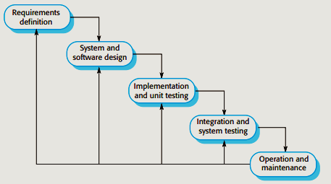
Water Fall Model Phases

Slide 27
Plan-driven Approaches
Plan-driven processes are processes where all of the process activities are planned in advance and progress is measured against this plan.
The waterfall model is not the right process model in situations where informal team communication is possible and software requirements change quickly.

Slide 28
Drawback of Water Fall Model
A Previous phase has to be complete before moving onto the next phase.
Inflexible partitioning of the project into distinct stages makes it difficult to respond to changing customer requirements.
The waterfall model is mostly used for large systems engineering projects where a system is developed at several sites.

Slide 29
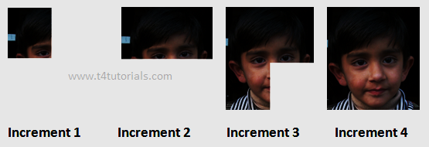
Incremental Development
Incremental development is based on the idea of developing an initial implementation, getting feedback from users and others, and evolving the software through several versions until the required system has been developed.

Slide 30
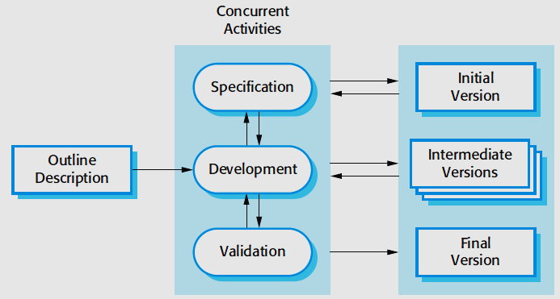
Incremental Development-Process

Slide 31
Incremental Development Benefits
The cost of implementing requirements changes is reduced. The amount of analysis and documentation that has to be redone is significantly less than is required with the waterfall model.
It is easier to get customer feedback on the development work that has been done. Customers can comment on demonstrations of the software and see how much has been implemented. Customers find it difficult to judge progress fromsoftware design documents.
Early delivery and deployment of useful software to the customer is possible, even if all of the functionality has not been included. Customers are able to use and gain value from the software earlier than is possible with a waterfall process..

Slide 32
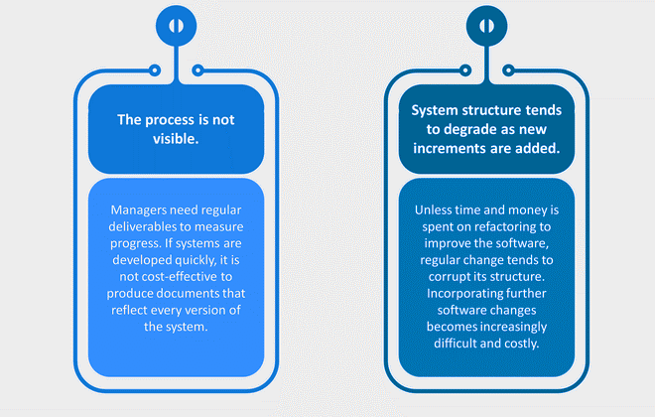
Incremental Approach Has Two Problems:
Problems might cause due to system architecture as such not all requirements collected up front for the entire software lifecycle

Slide 33
Integration and configuration
Based on software reuse where systems are integrated from existing components or application systems (sometimes called COTS -Commercial-off-the-shelf) systems).
Reused elements may be configured to adapt their behaviour and functionality to a user’s requirements
Reuse is now the standard approach for building many types of business system

Slide 34
Types of reusable software
Stand-alone application systems (sometimes called COTS) that are configured for use in a particular environment.
Collections of objects that are developed as a package to be integrated with a component framework such as .NET or J2EE.
Web services that are developed according to service standards and which are available for remote invocation.

Slide 35
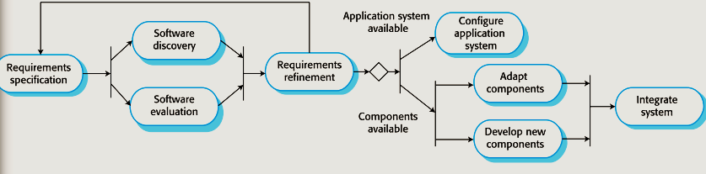
Reuse oriented software engineering
The requirements are modified to reflect the available components, and the system specification is re-defined.
The initial requirements for the system are proposed. These do not have to be elaborated in detail but should include brief descriptions of essential requirements and desirable system features.
Candidate components and systems are evaluated to see if they meet the essential requirements and if they are generally suitable for use in the system.
If an off-the-shelf application system that meets the requirements is available, it may then be configured for use to create the new system.
n If there is no off-the-shelf system, individual reusable components may be modified and new components developed.

Slide 36
Reuse-oriented software engineering
configuration and integration, has the obvious advantage of reducing the amount of software to be developed and so reducing cost and risks.
It usually also leads to faster delivery of the software.

Slide 37
Process-Activity
The four basic process activities:
Specification
Development
Validation
evolution
are organized differently in different development processes.
In the waterfall model, they are organized in sequence, whereas in incremental development they are interleaved.
How these activities are carried out depends on the type of software being developed, the experience and competence of the developers, and the type of organization developing the software.

Slide 38
Software specification/ Requirements Engineering
Software specification or requirements engineering is the process of understanding and defining what services are required from the system and identifying the constraints on the system’s operation and development.
Requirements engineering is a particularly critical stage of the software process, as mistakes made at this stage inevitably lead to later problems in the system design and implementation.
Before the requirements engineering process starts, a company may carry out a feasibility or marketing study to assess whether or not there is a need or a market for the software

Slide 39
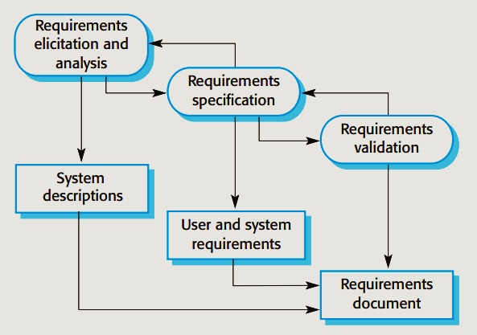
Requirements Engineering Process
translating the information gathered during requirements analysis into a document that defines a set of requirements.
User requirement
End-User requirement
This is the process of deriving the system requirements through observation of existing systems
This activity checks the requirements for realism, consistency, and completeness

Slide 40
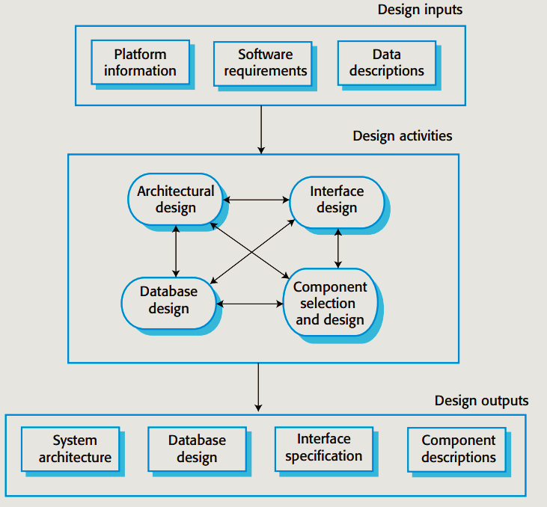
Software design and implementation
The implementation stage of software development is the process of developing an executable system for delivery to the customer.

Slide 41
Class 06 19-feb-2021

Slide 42
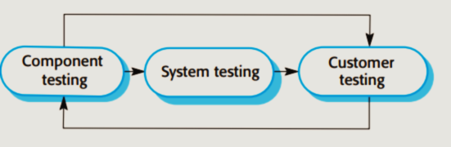
Software validation
Software validation or, more generally, verification and validation (V & V) is intended to show that a system both conforms to its specification and meets the expectations of the system customer.
Figure shows a three-stage testing process in which system components are individually tested, then the integrated system is tested.

Slide 43
Software validation-Component testing
Component testing The components making up the system are tested by the people developing the system.
Each component is tested independently, without other system components. Components may be simple entities such as functions or object classes or may be coherent groupings of these entities.
Test automation tools, such as JUnit for Java, that can rerun tests when new versions of the component are created, are commonly used

Slide 44
Software validation-System testing
System testing System components are integrated to create a complete system.
For large systems, this may be a multistage process where components are integrated to form subsystems that are individually tested before these subsystems are integrated to form the final system

Slide 45
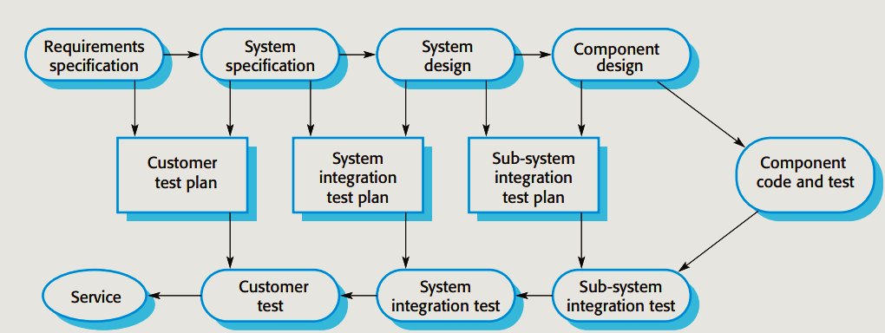
Plan-driven Software Process

Slide 46
Beta Testing
When a system is to be marketed as a software product, a testing process called beta testing is often used.
Beta testing involves delivering a system to a number of potential customers who agree to use that system.
They report problems to the system developers. This exposes the product to real use and detects errors that may not have been anticipated by the product developers.
After this feedback, the software product may be modified and released for further beta testing or general sale.

Slide 47
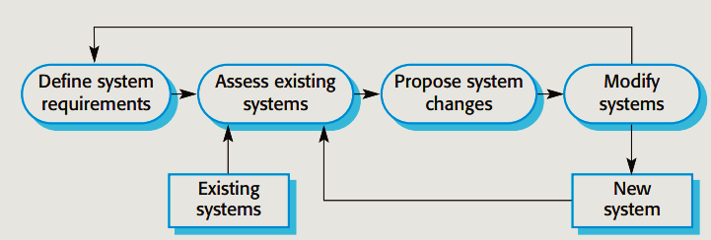
Software evolution
This distinction between development and maintenance is increasingly irrelevant.
Very few software systems are completely new systems, and it makes much more sense to see development and maintenance as a continuum.
Rather than two separate processes, it is more realistic to think of software engineering as an evolutionary process where software is continually changed over its lifetime in response to changing requirements and customer needs.

Slide 48
Approaches May Be Used To Reduce The Costs Of Rework:
The system requirements change as businesses respond to external pressures.
Change anticipation
For example, a prototype system may be developed to show some key features of the system to customers. They can experiment with the prototype and refine their requirements before committing to high software production cost.
Change Tolerance
Proposed changes may be implemented in increments that have not yet been developed. If this is impossible, then only a single increment (a small part of the system) may have to be altered to incorporate the change.

Slide 49
Two Ways Of Coping With Change And Changing System Requirements
System prototyping
Incremental delivery

Slide 50
Prototyping
A prototype is an early version of a software system that is used to demonstrate concepts, try out design options, and find out more about the problem and its possible solutions.
A software prototype can be used in a software development process to help anticipate changes that may be required:
In the requirements engineering process, a prototype can help with the elicitation and validation of system requirements.
In the system design process, a prototype can be used to explore software solutions and in the development of a user interface for the system.

Slide 51
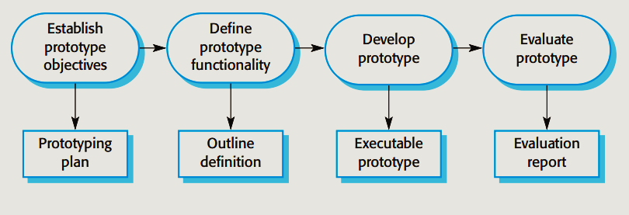
Prototype
System prototypes allow potential users to see how well the system supports their work.
They may get new ideas for requirements and find areas of strength and weakness in the software.

Slide 52
Prototype-Example
A database design may be prototyped and tested to check that it supports efficient data access for the most common user queries.
Rapid prototyping with end-user involvement is the only sensible way to develop user interfaces. Because of the dynamic nature of user interfaces, textual descriptions and diagrams are not good enough for expressing the user interface requirements and design

Slide 53
Incremental delivery
Customers can use the early increments as prototypes and gain experience that informs their requirements for later system increments.
The first increment satisfies their most critical requirements, so they can use the software immediately.
As the highest priority services are delivered first and later increments then integrated, the most important system services receive the most testing. This means that customers are less likely to encounter software failures in the most important parts of the system

Slide 54
Capability Maturity Model
The Software Engineering Institute (SEI) Capability Maturity Model (CMM) specifies an increasing series of levels of a software development organization.
The higher the level, the better the software development process, hence reaching each level is an expensive and time-consuming process.
This idea was introduced so that the U.S. Department of Defense

Slide 55
Capability Maturity Levels
Optimizing
Quantitatively managed
Defined
Managed
Initial

Slide 56
Activity
What are attributes of good software ?0
A. Software maintainability B. Software functionality C. Software development D. Software maintainability & functionality
What is a Software ____________________ ?0
A. Software is set of programs B. Software is documentation and configuration of data C. Software is set of programs, documentation & configuration of data D. None of the mentioned

Slide 57
Which of these software engineering activities are not a part of software processes ?
Software development
Software dependence
Software validation
Software specification
Which one of the following models is not suitable for accommodating any change?
Prototyping Model
RAD Model
Build & Fix Model
Waterfall Model

Slide 58
SDLC stands for
System Development Life cycle
Software Design Life Cycle
Software Development Life Cycle
System Design Life Cycle
How many numbers of maturity levels in CMM are available?
6
5
4
3

Slide 59
Analysis
Suggest the most appropriate generic software process model that might be used as a basis for managing the development of the following systems. Explain your answer according to the type of system being developed:
a) A system to control anti-lock braking in a car
b) A virtual reality system to support software maintenance
c) A university accounting system that replaces an existing system
d) An interactive travel planning system that helps users plan journey with the lowest environment impact

Slide 60
Analysis
a) Anti-lock braking system This is a safety-critical system so requires a lot of up-front analysis before implementation. It certainly needs a plan-driven approach to development with the requirements carefully analysed. A waterfall model is therefore the most appropriate approach to use, perhaps with formal transformations between the different development stages.
b) Virtual reality system This is a system where the requirements will change and there will be an extensive user interface components. Incremental development with, perhaps, some UI prototyping is the most appropriate model. An agile process may be used.

Slide 61
Analysis
c) University accounting system This is a system whose requirements are fairly well-known and which will be used in an environment in conjunction with lots of other systems such as a research grant management system. Therefore, a reuse-based approach is likely to be appropriate for this.
d) Interactive travel planning system with a complex user interface but which must be stable and reliable. An incremental development approach is the most appropriate as the system requirements will change as real user experience with the system is gained

Slide 62
Thankyou

